Slide 1
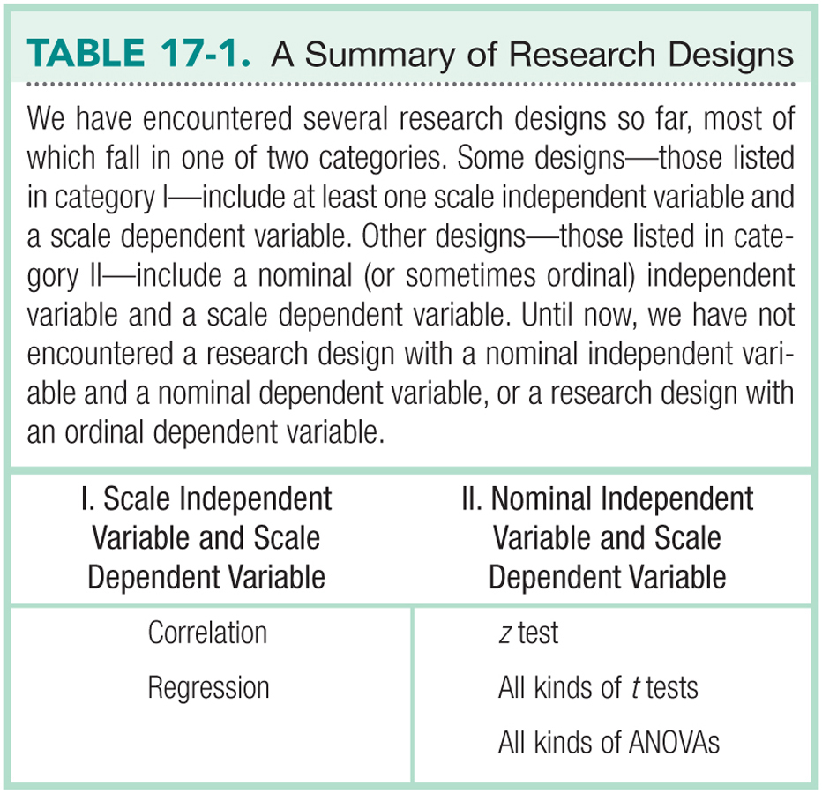

Slide 2
Chi-Square Test for Goodness-of-Fit
Nonparametric test when we have one nominal variable
The six steps of hypothesis testing
    1. Identify
    2. State the hypotheses
    3. Characteristics of the comparison distribution
    4. Critical values
    5. Calculate
    6. Decide

Slide 3
Formulae

Slide 4
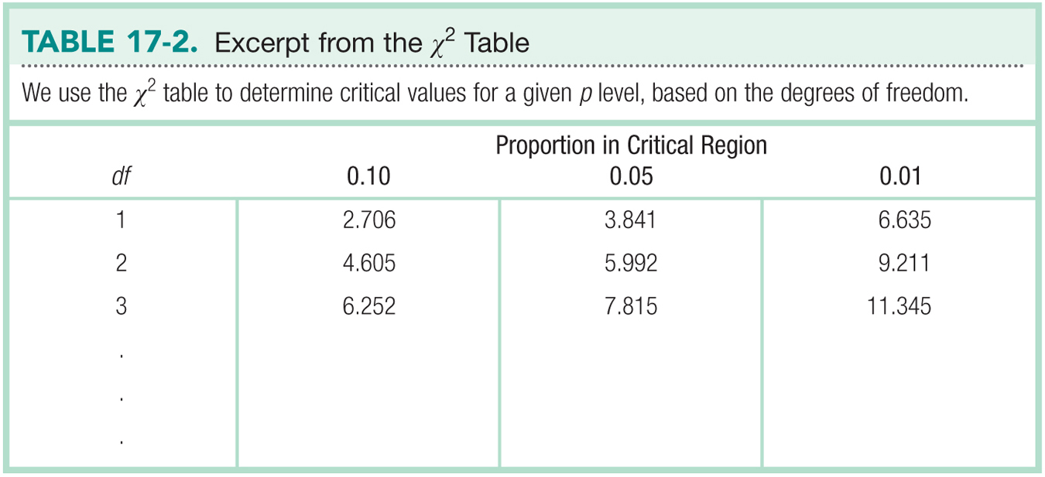

Slide 5
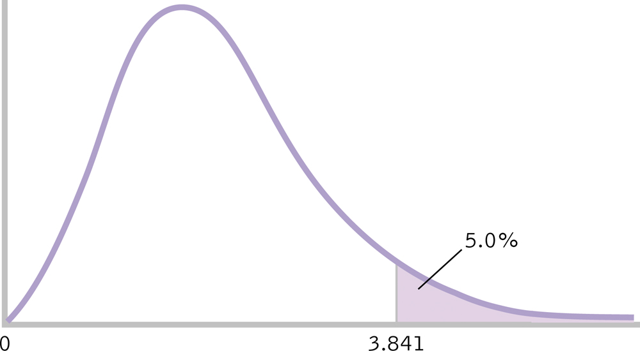
Determining the Cutoff for a Chi-Square Statistic

Slide 6
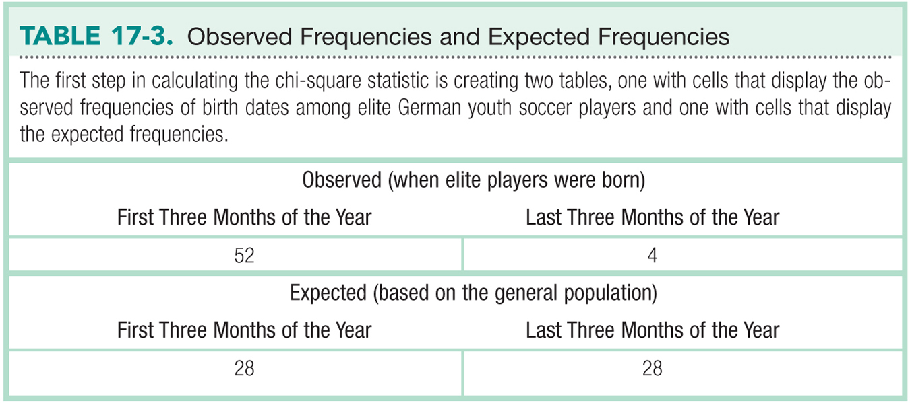

Slide 7
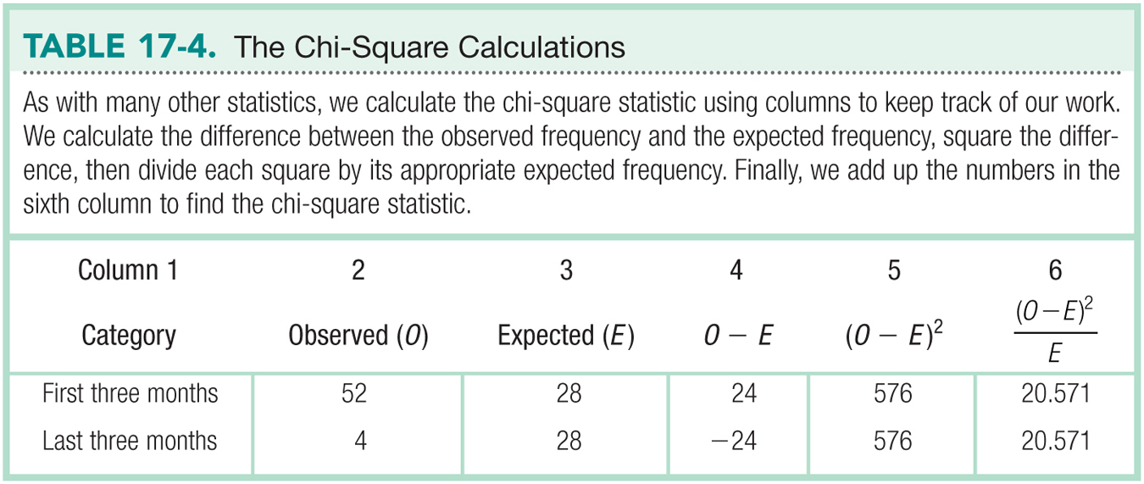

Slide 8
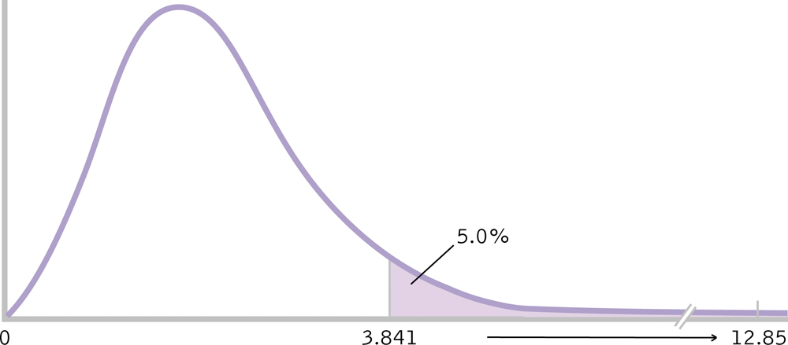
Making a Decision

Slide 9
A more typical Chi-Square
Evenly divided expected frequencies
  Can you think of examples where you would expect evenly divided expected frequencies in the population?

Slide 10
Chi-square test for independence
  Analyzes 2 nominal variables
  The six steps of hypothesis testing
    1. Identify
    2. State the hypotheses
    3. Characteristics of the comparison distribution
    4. Critical values
    5. Calculate
    6. Decide

Slide 11
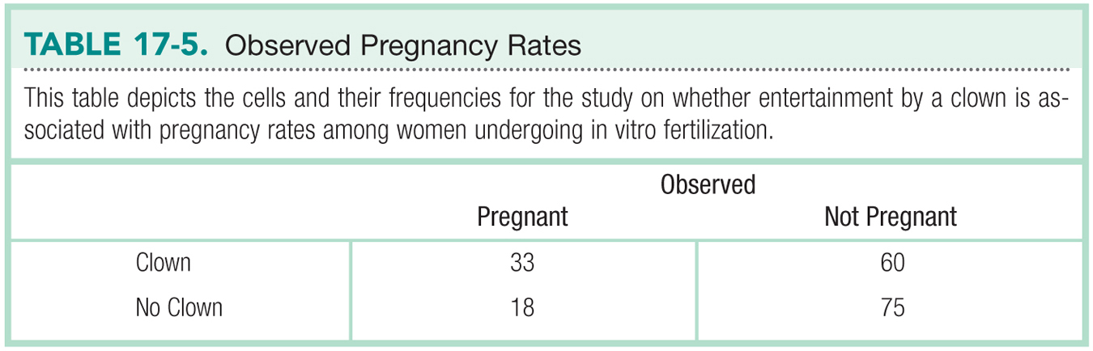

Slide 12

The Cutoff for a Chi-Square Test for Independence

Slide 13
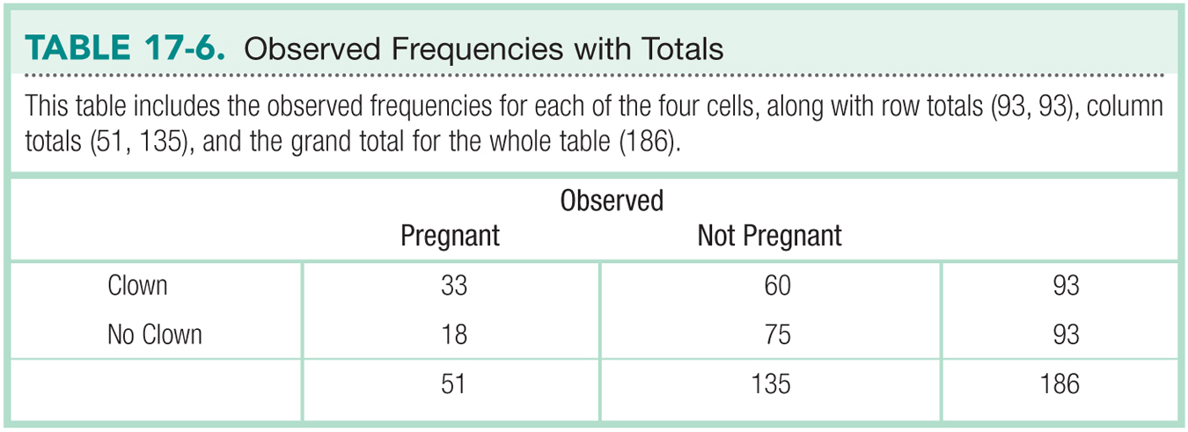

Slide 14
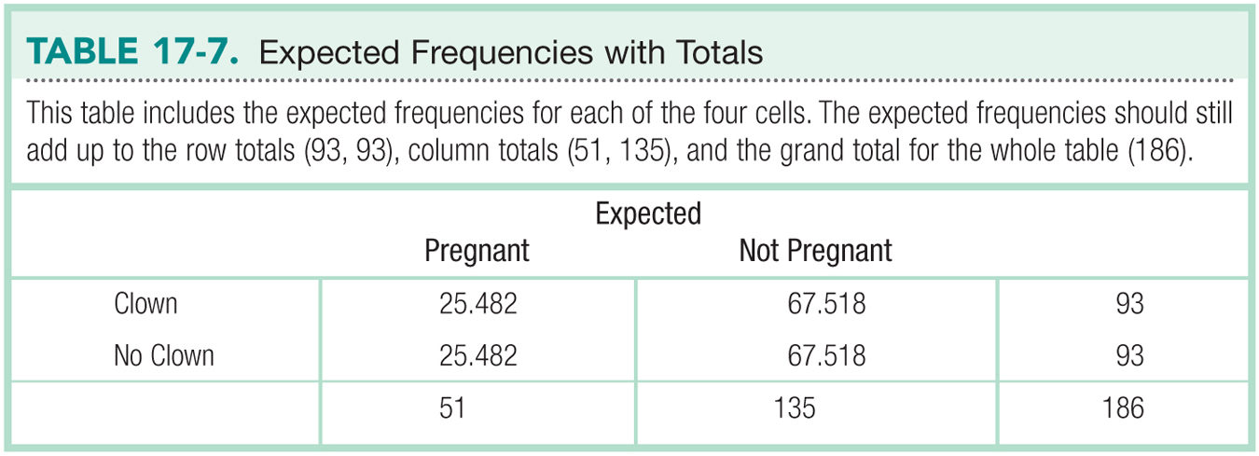

Slide 15
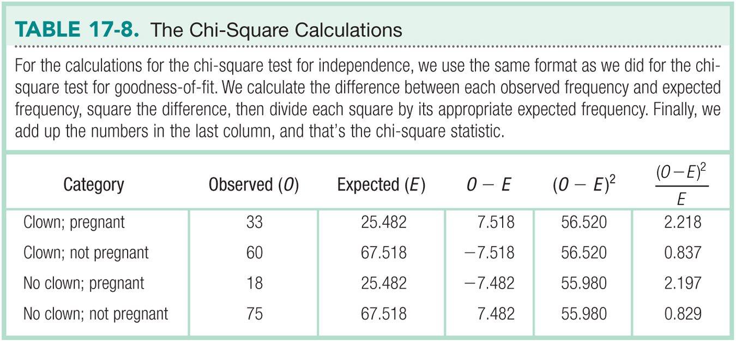

Slide 16
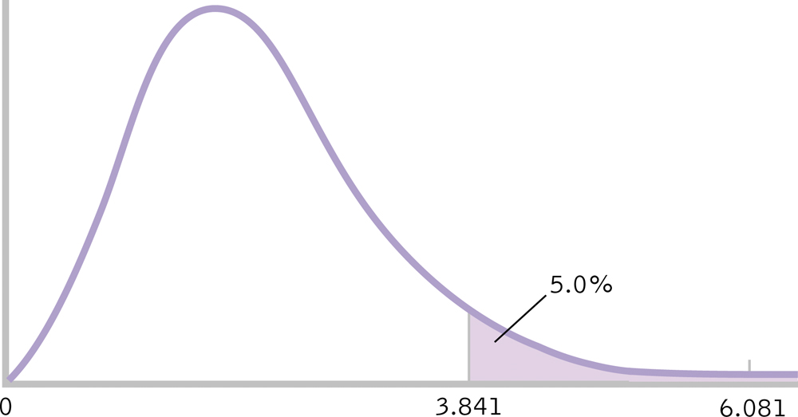
The Decision

Slide 17
Cramer’s V (phi)
The effect size for chi-square test for independence

Slide 18
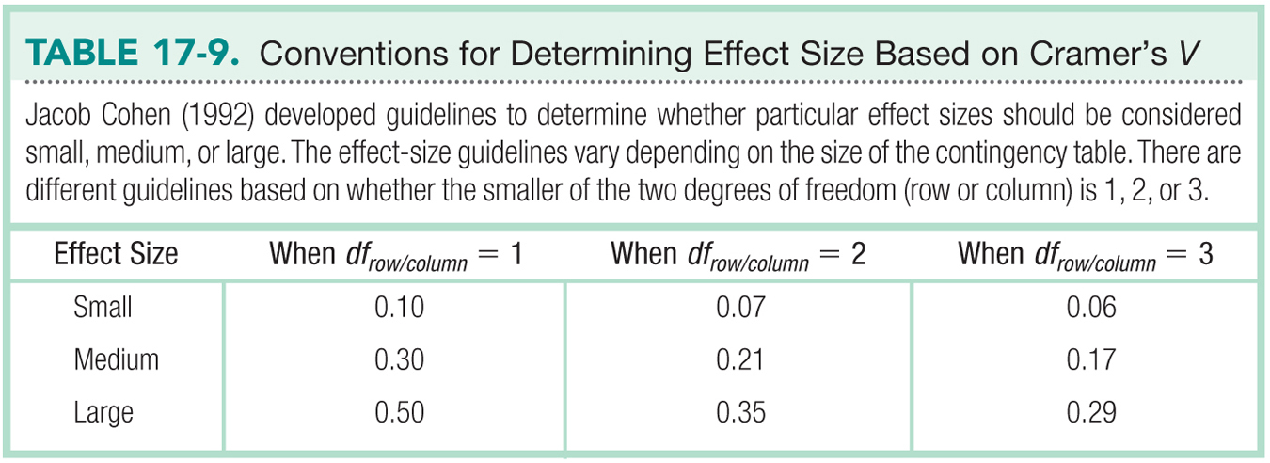

Slide 19
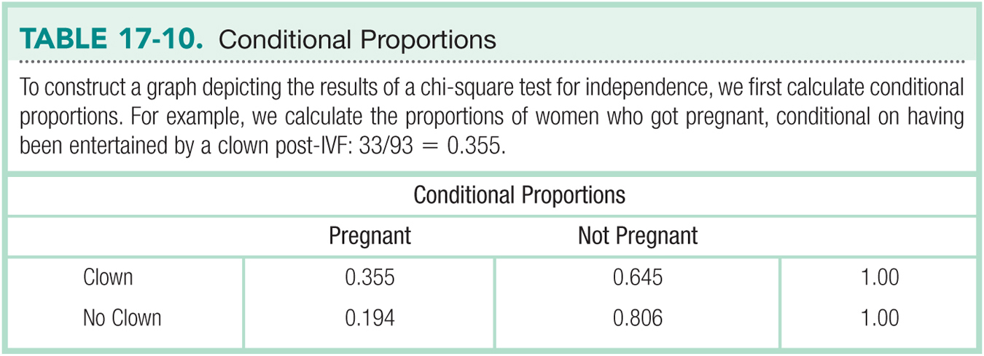
Graphing Chi-Squared Percentages

Slide 20
Relative Risk
We can quantify the size of an effect with chi square through relative risk, also called relative likelihood.
By making a ratio of two conditional proportions, we can say, for example, that one group is three times as likely to show some outcome or, conversely, that the other group is one-third as likely to show that outcome.

Slide 21
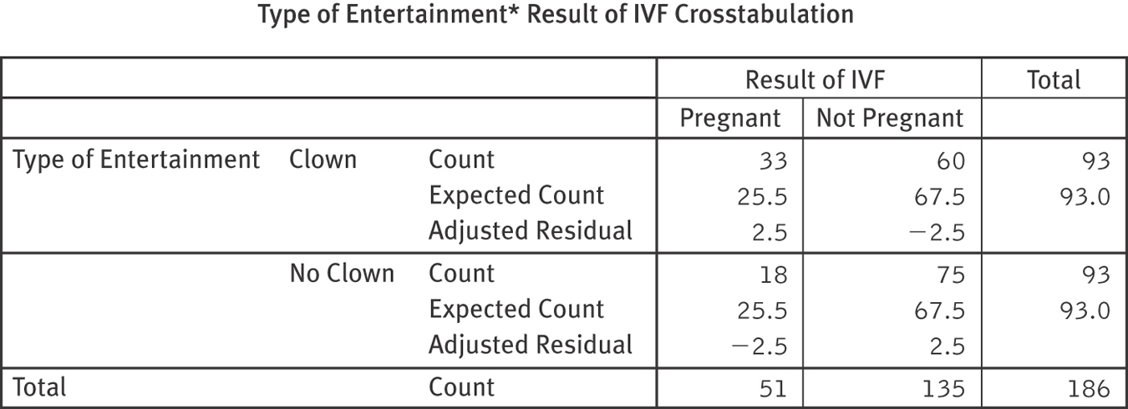
Adjusted Standardized Residuals
The difference between the observed frequency and the expected frequency for a cell in a chi-square research design, divided by the standard error; also called adjusted residual.

