Slide 1
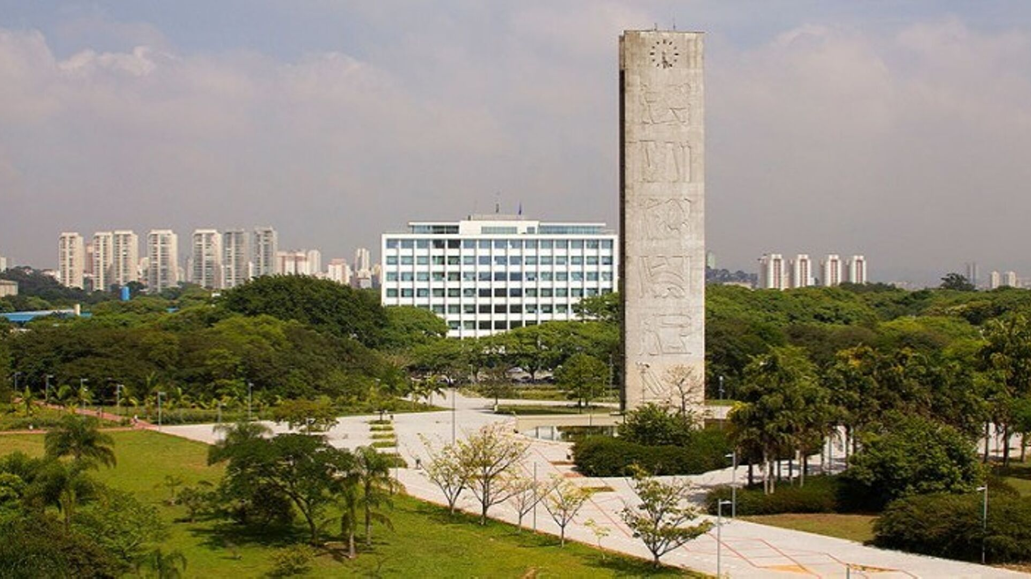
International Sustainable
Campus Network
2019 São Paulo Conference
Conference Report - Superintendence of Environmental Management (SGA)

Slide 2
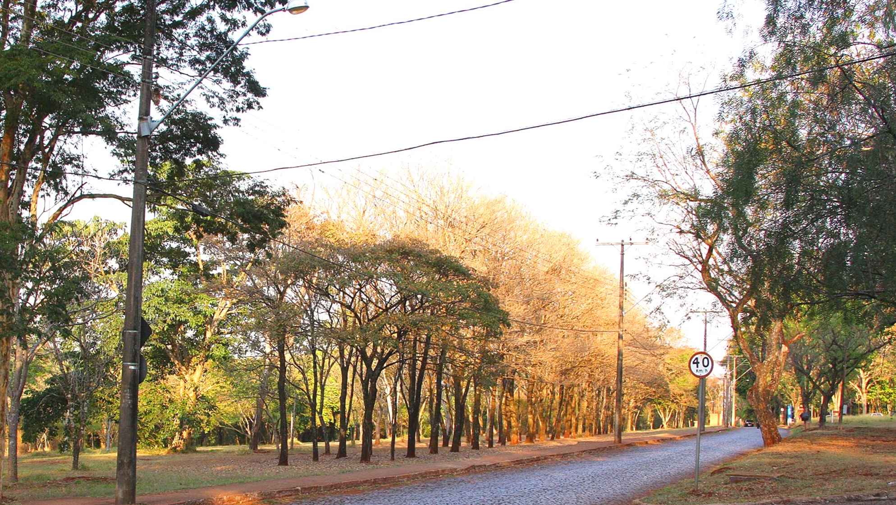
Report autors
The production of this report is conducted by the Superintendence of Environmental Management (SGA) of USP, responsible for promoting sustainability at USP.

Slide 3
The International Sustainable Campus Network (ISCN) is a non-profit association of globally leading colleges and universities representing over 30 countries and working together to holistically integrate sustainability into campus operations, research and teaching.
The ISCN is governed by the ISCN Board, composed of senior representatives of the ISCN co-host member universities. The Board is supported by an ISCN Advisory Committee that includes representatives elected by the ISCN network universities.

Slide 4
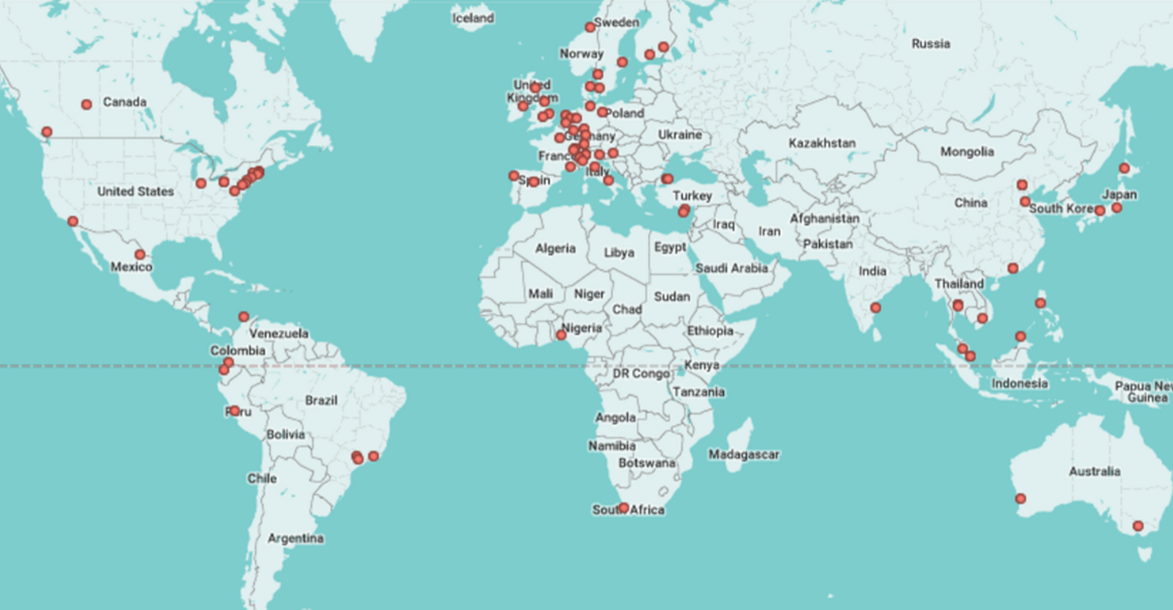
2019 Membership Statistics: 90+ members | 30+ countries | 2M+ students

Slide 5
The São Paulo ISCN 2019
The 2019 edition of the ISCN will be held in June at the University of São Paulo (USP), Brazil.
More than 30 years ago our University initiated actions for reduction of social environmental impacts. Due to its great territorial extension and diverse ecosystems, our campuses are challenging and enriching scenarios for sustainability actions.
Thanks to a joint effort of the entire university community, important results have been achieved. We figure as the most sustainable Latin America Institution in the Greenmetrics for Universities ranking... and thanks to a vast amount of preserved forest areas we occupy the first place in the Global ranking for Setting and Infrastructure.
Now we have to coordinate our strengths and step forward, to make our institution establish itself as an integrating hub of sustainable development for its surroundings and act as a national living lab for sustainability challenges. Hosting the "Partnerships for Progress" 2019 ISCN is a great honor... and poses as an excellent opportunity for us to expand and consolidated a network of agents compromised with our common future.

Slide 6
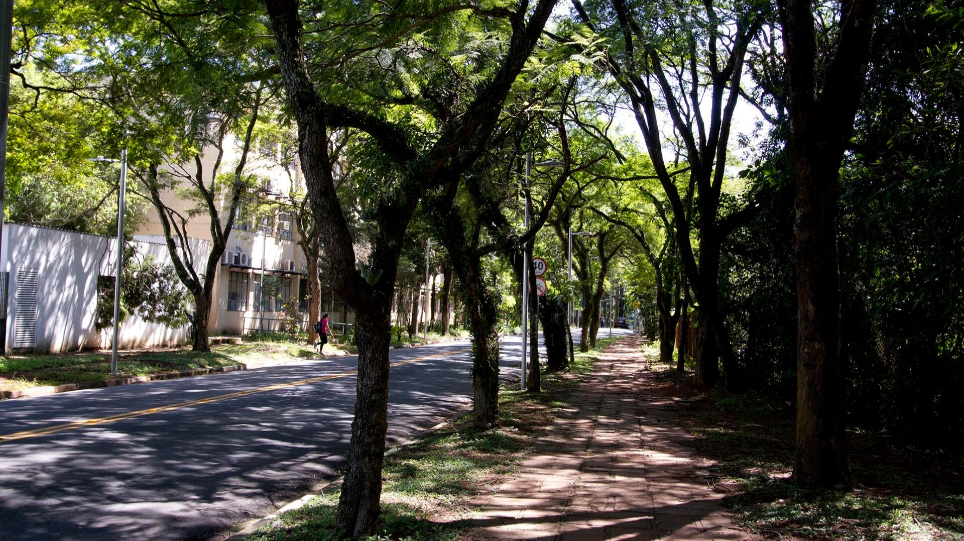
DAY 1 - JUNE 12
At Main Campus USP - Biblioteca Brasiliana Guita e José Mindlin
Opening Cerimony
Keynote Speaker
ConverStations
Plenary Session 1: Partnership for progress
Thematic University Tour

Slide 7
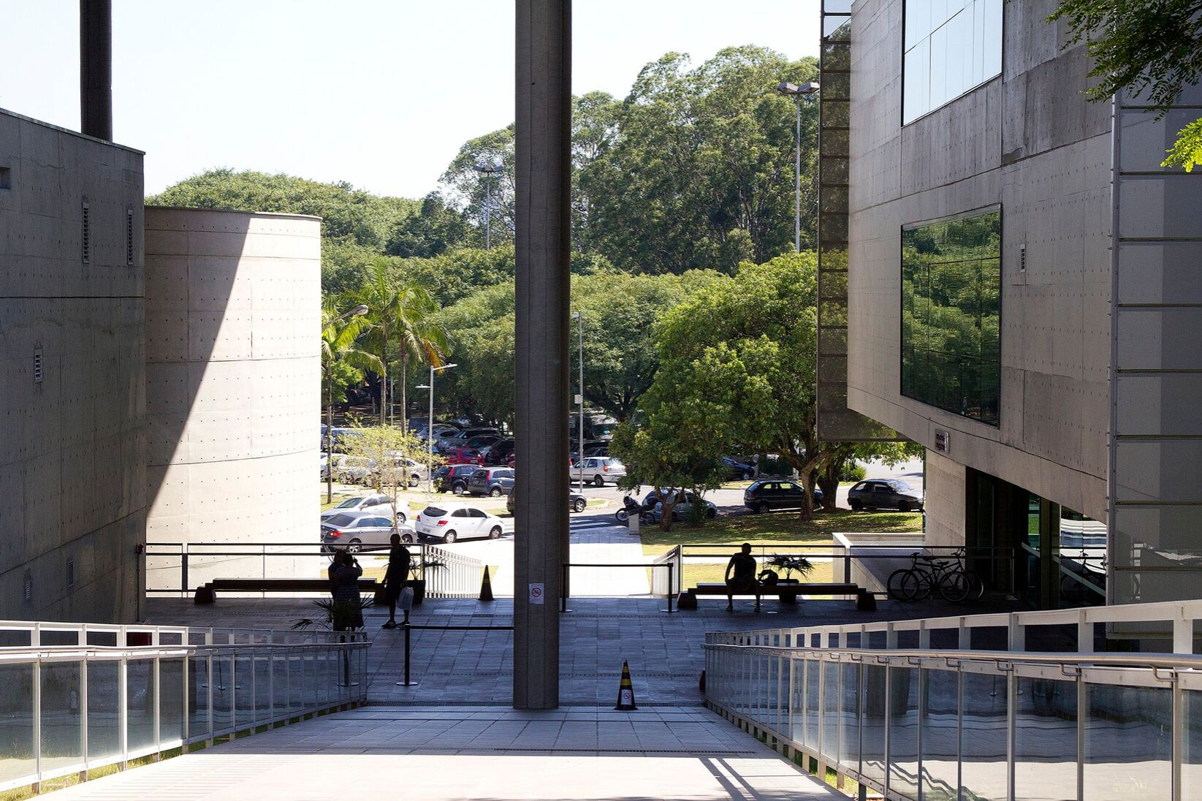
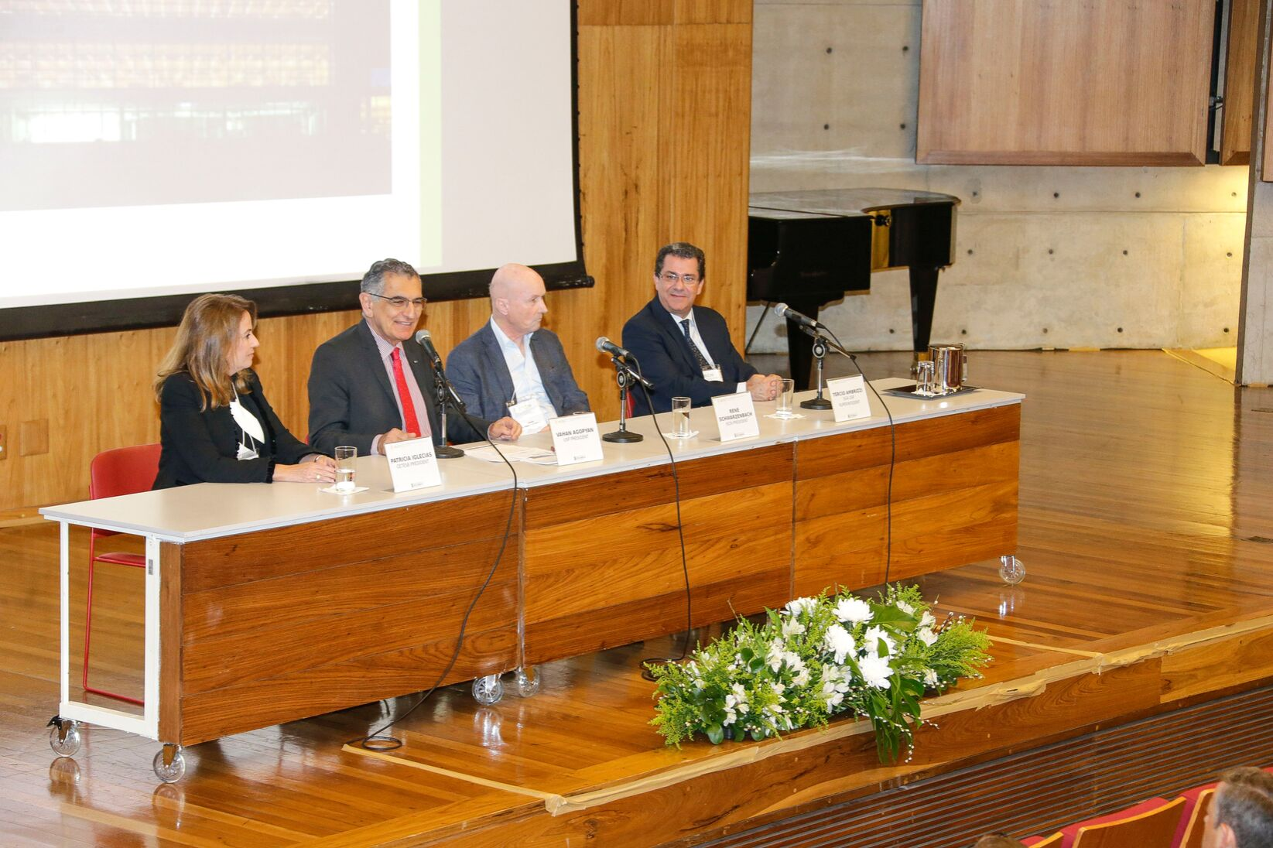
Opening ceremony
Prof. Vahan Agopyan, Rector, USP
PROF. TÉRCIO AMBRIZZI, HEAD, SGA-USP
Prof. Patrícia Iglecias , Conference Coordinator
René Schwarzenbach, President of the ISCN Board

Slide 8
Prof. Vahan Agopyan
“In addition to implementing actions to make campuses increasingly sustainable, encouraging environmental research and developing environmental policies, universities have a responsibility to prepare future world leaders. Our great challenge is to ensure that future generations are committed to the environment, not only in speech, but as something effective and present in their daily lives.”
Source: Jornal USP

Slide 9
Prof. Tércio Ambrizzi
“Being one of the largest universities in the world, USP is aware of the environmental impact generated by its activities and has implemented actions that promote sustainability in its campuses.
We show that USP has placed itself within the global context as a university that seeks sustainability and that its projects can become an example for all of society.”
Source: Jornal USP

Slide 10
Prof. Patrícia Faga Iglecias Lemos
“To achieve our goals in terms of sustainability, we need to work in partnership: the government, the private sector, the productive sector and universities. This conference is an opportunity to show what is being done in different parts of the world.”
Source: Jornal USP

Slide 11
René Schwarzenbach
“This is an opportunity to exchange experiences on the culture of sustainability in universities and to assess how knowledge about the environment is being transferred to society and how we could relate better and establish partnerships for progress.”
Source: Jornal USP
USP imagens

Slide 12
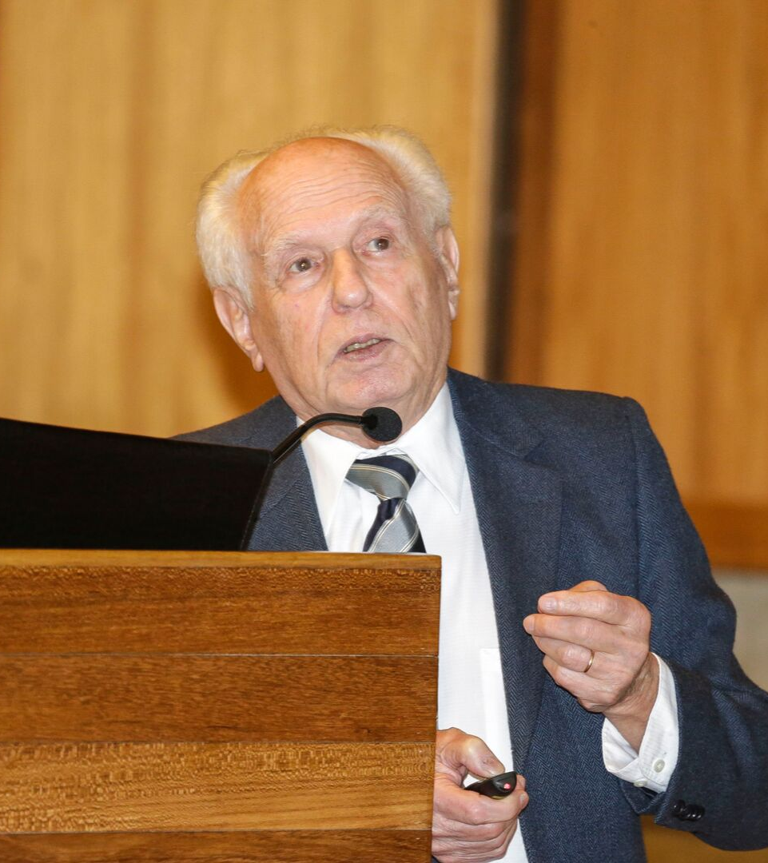
KEYNOTE SPEAKER - PROFESSOR JOSÉ GOLDEMBERG - USP
ISCN had the privilege of having Professor Goldemberg, as the opening keynote, talking about his research on development and use of ethanol as fuel.
Professor José Goldemberg earned his Ph.D. in Physical Sciences from the University de São Paulo in 1954, where he held the position of Professor in the Engineering School’s Physics Department. He was Rector of the University from 1986 to 1991. A Member of the Brazilian Academy of Sciences, he has served as the President of Brazilian Association for the Advancement of Science and President of the Energy Company of the State of São Paulo.

Slide 13
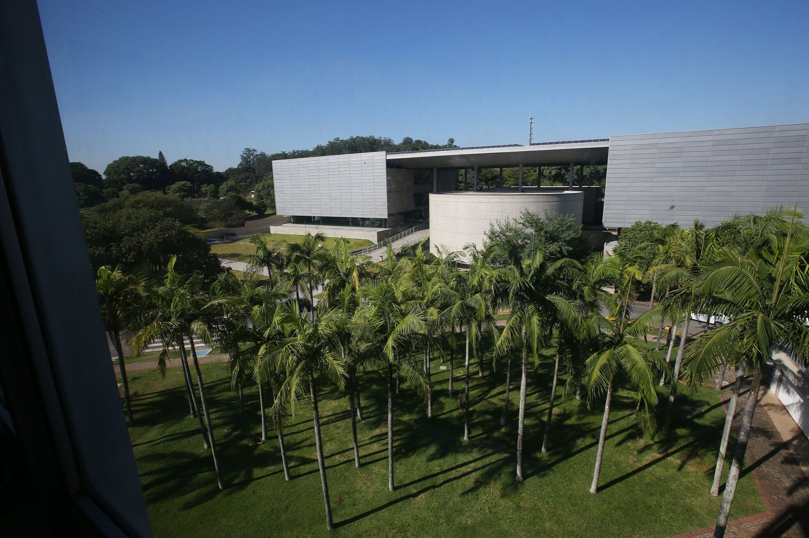
CONVERSTATIONS
Massachusetts Institute of Technology - Julie Newman, Director of Sustainability
Pontificia Universidad Catolica del Peru - Héctor Miranda Plaza, Sustainable Development Consultant
Siam University - Professor Emeritus Dr. Chanita Rukspollmuang, Vice President
Thammasat University - Prinya Thaewanarumitkul, Ph.D., Assistant Professor, Vice Rector for Sustainability and Rangsit Campus Administration
Universidad Nacional Autónoma de México - César A. Ríos Muñoz, Office for Sustainable University
The University of Hong Kong - Joy Lam, Sustainability Office
The University of Melbourne - Clare Walker, Associate Director, Sustainability

Slide 14
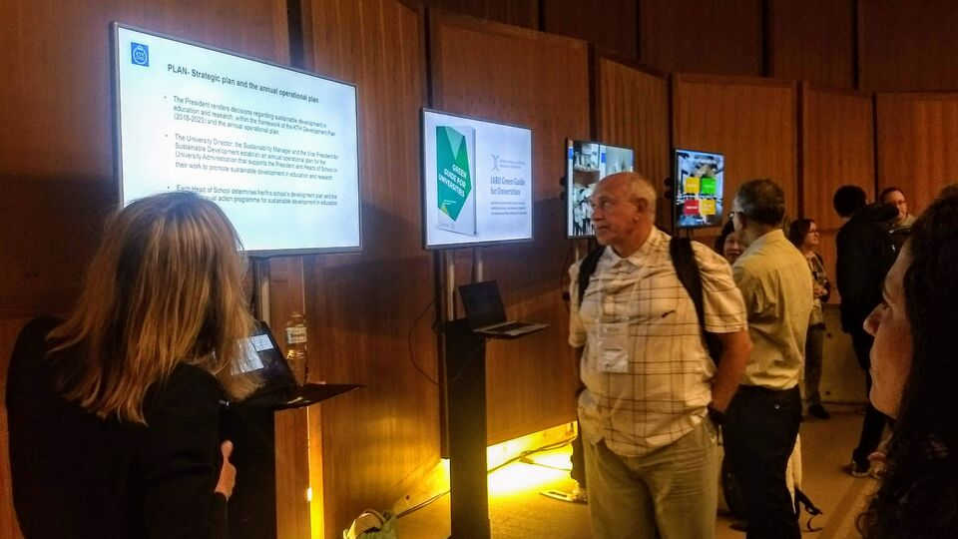
Participants could attend several short presentations that took place simultaneously on projects and actions that have been developed in Universities around the world. A moment that allows closer contact between the participants, brainstorming and the exchange of experiences.

Slide 15
Plenary Session: Partnerships for progress
AMS Institute - Leendert Verhoef, Program Lead Living Labs
Leuphana University Luneburg - Matthias Barth, Professor of Education for Sustainable Development
Portland State University - Fletcher Beaudoin, Associate Director

Slide 16
Thematic University Tour
Thematic visits were an opportunity to broaden and enrich the participants' experience by bringing new perspectives on different topics.

Slide 17
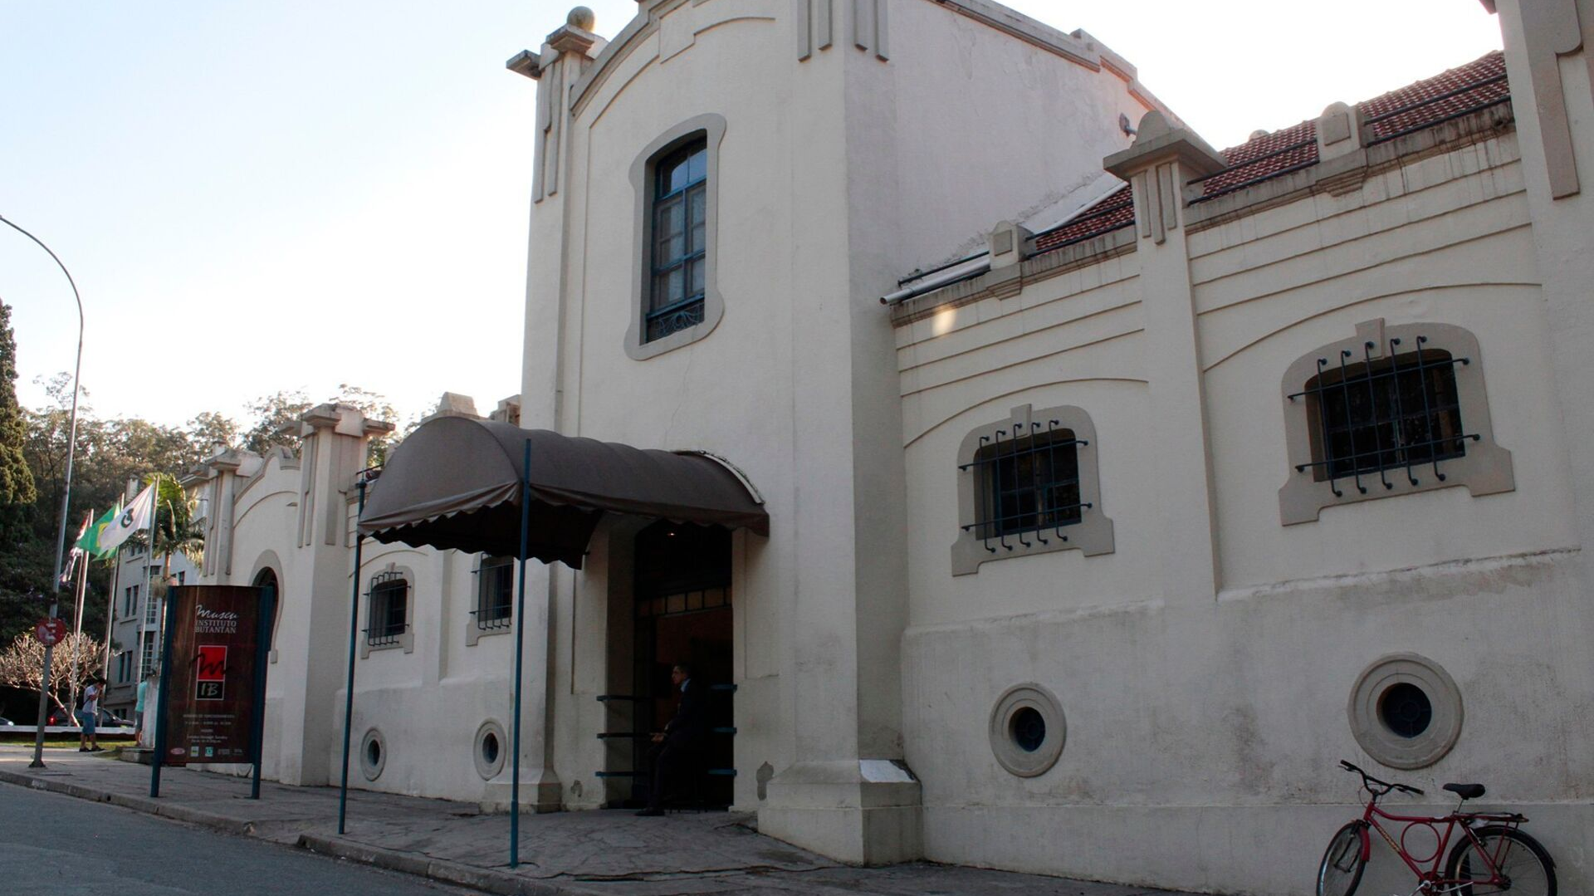
The Butantan Institute
The Butantan Institute, as one of Brazil's most prestigious scientific institutions, generates new knowledge through scientific research, develops and produces immunobiological and biopharmacological products of interest to public health, educates and trains human resources in the areas of science and technology, and seeks to stimulate scientific knowledge and understanding among the general population. With 113 years of existence marked by numerous technological advances directed towards public health issues, the Butantan Institute is considered one of the major scientific centers in the world.

Slide 18
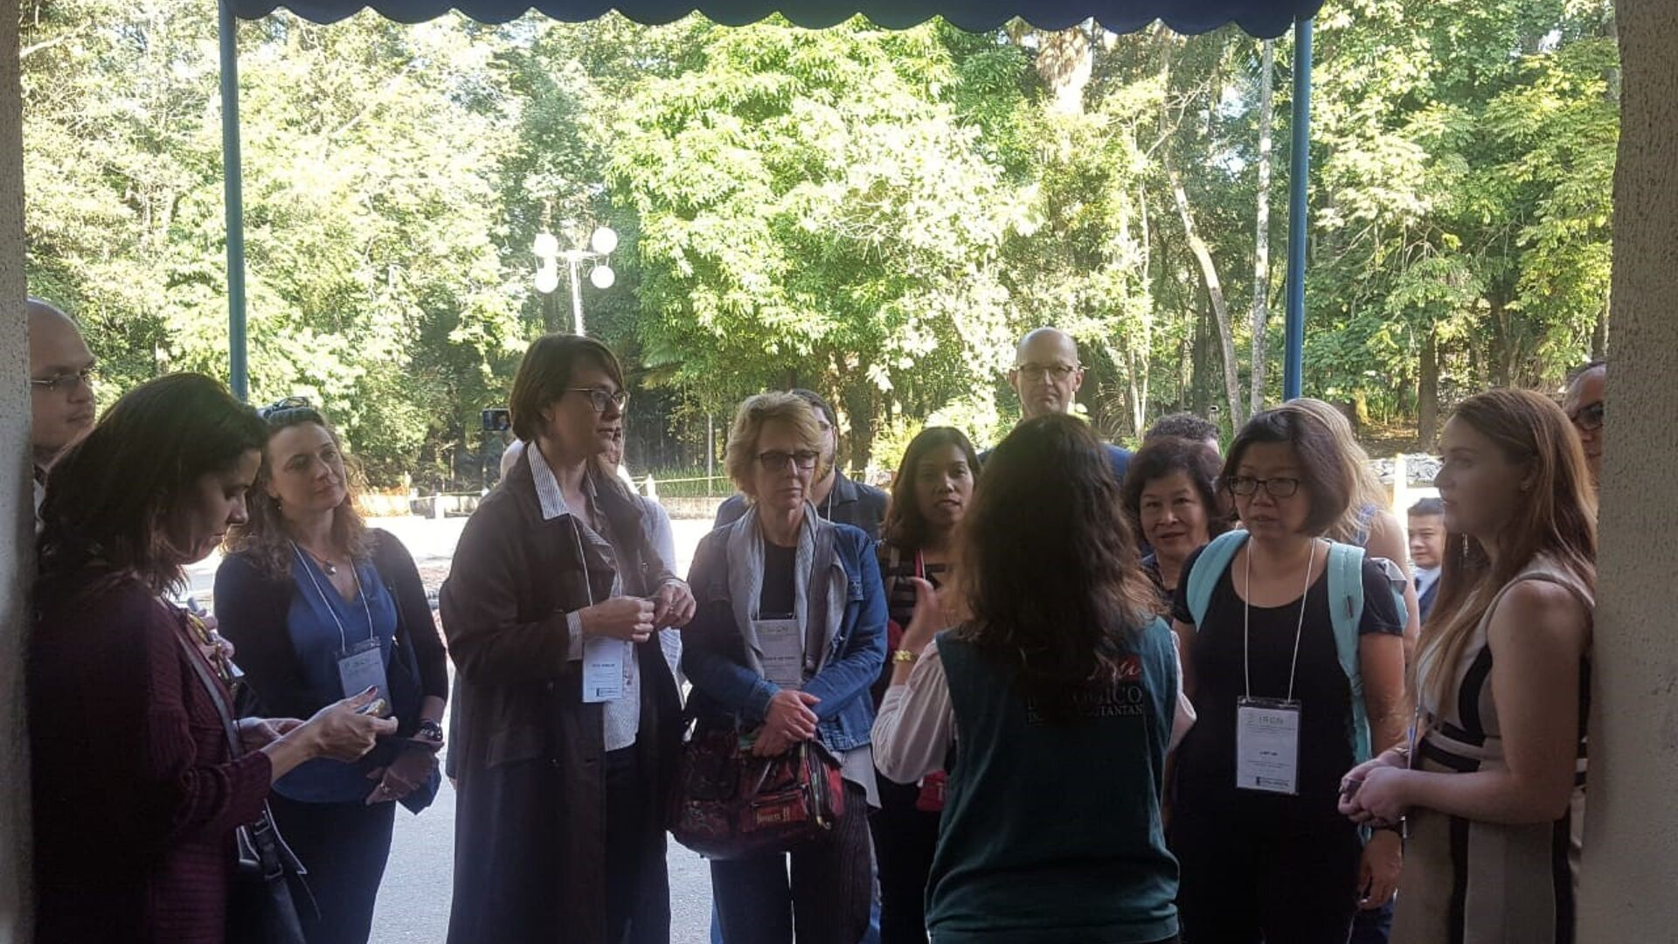
The Butantan Institute

Slide 19
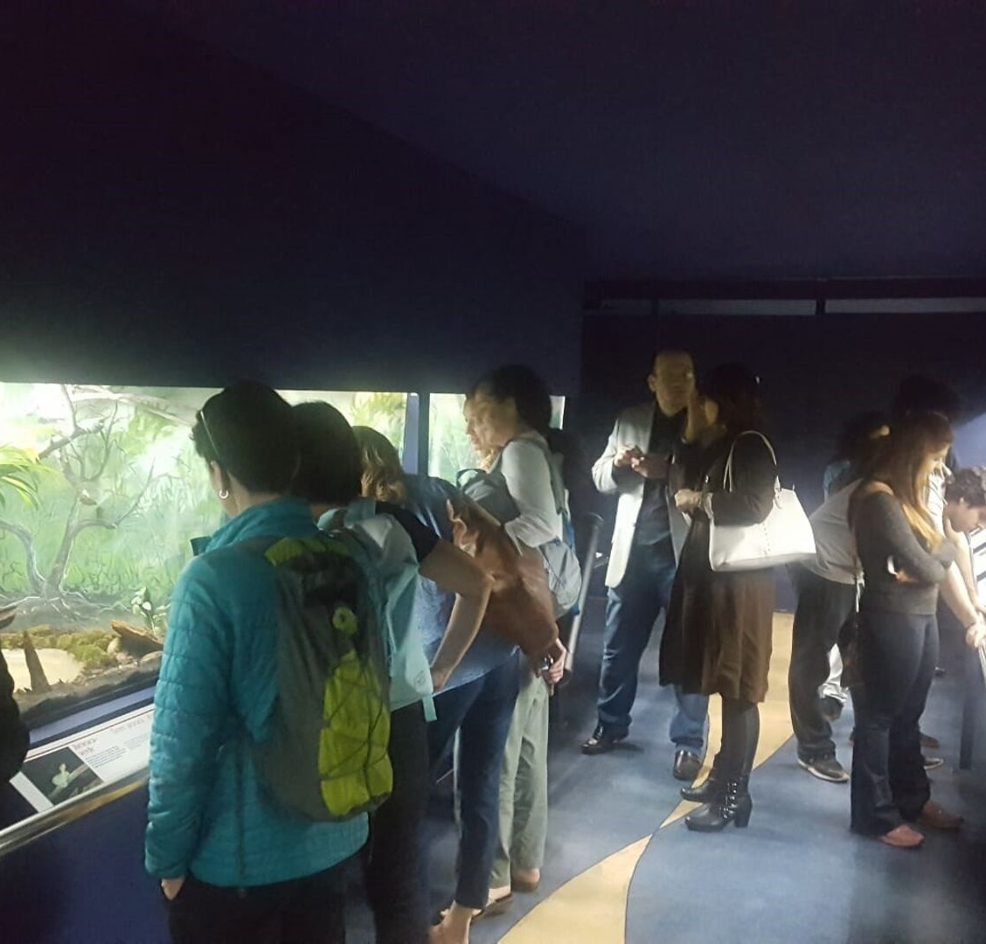
The Butantan Institute
The visit to the Butantan Institute aimed at guiding the preservation of biodiversity within the scope of promoting sustainability. The site has a history of research, very peculiar within the national context, that signals the relevance of the preservation of species from a non-instrumental or economic perspective.
The immersion within the staff began during the path, when it was possible to observe the fascination with which some of the participants perceived the flora, fauna and historical heritage within the campus. Upon arrival at the institute, the immersion gained another dimension and the beauty was covered with the peculiar curiosity that every researcher carries, this feeling was appropriately and cordially worked out by the institute's team of researchers, who was very proud of the work performed and the patrimony represented. The tour ended with a short presentation, which aligned the institute's history as a promoter of basic and applied science and the preservation of biodiversity.
The message that remains of the tour is that the capture of biodiversity, concentrated in the Butantã Institute and dispersed throughout the campus, instigates reflection about our position within nature, and a reinvention of our conception of the environment and the consequent appreciation of the biodiversity.

Slide 20
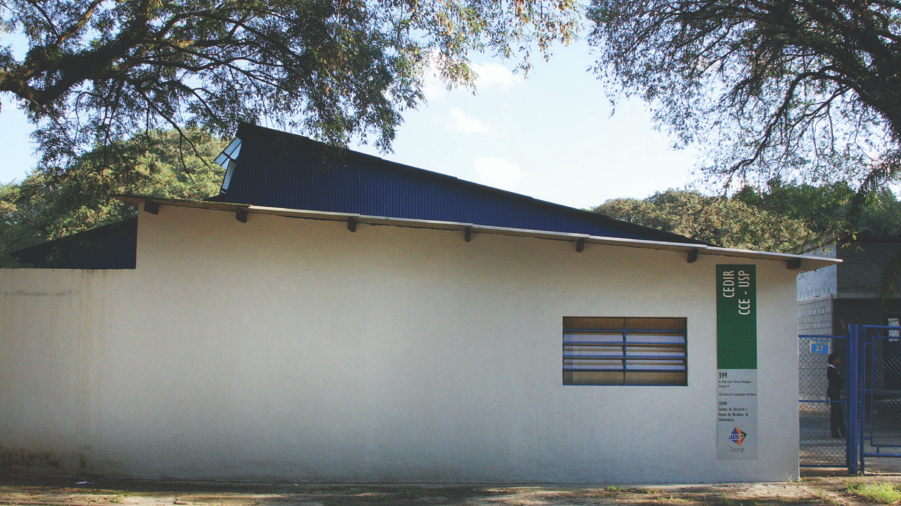
Center for Disposal and Reuse of Computer Waste (CEDIR)
Open to the public since 2009, the Center for Disposal and Reuse of Computer Waste (CEDIR), installed at the University of São Paulo's Polytechnic School, accepts computers and electronic materials for reuse or recycling. CEDIR helps to reuse or responsibly dispose materials such as computers, mice, printers, cables and mobile phones. CEDIR serves as a benchmark at the national level for the performance of its activities and is reguarly visited by schools, universities and companies that attend talks about the technology recycling evolution.

Slide 21
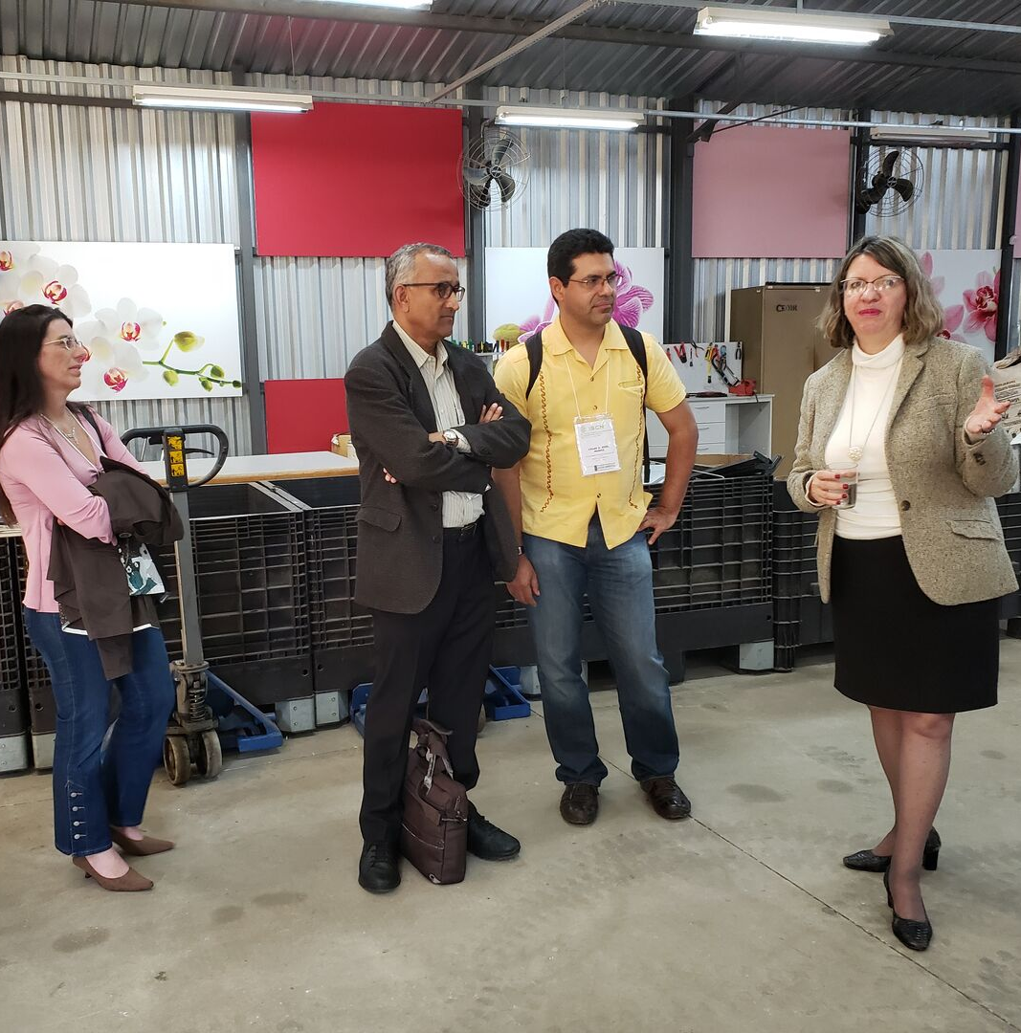
Center for Disposal and Reuse of Computer Waste (CEDIR)
During this visit, participants had the experience of walking on the campus, observing tourist and symbolic points such as the clock tower and the rectory building and were surprised by the presence and diversity of trees along the way.
The visit was guided by Tereza Cristina Carvalho (Professor Associated USP), which explained part of the history of CEDIR and the process of Reuse of Computer Waste.
At the end of the visit the participants met high school students who participate in robotics classes, an activity that is part of the project to talk and exchange experiences. It was an unique moment that symbolized the breakdown of geographical and cultural barriers for both.

Slide 22
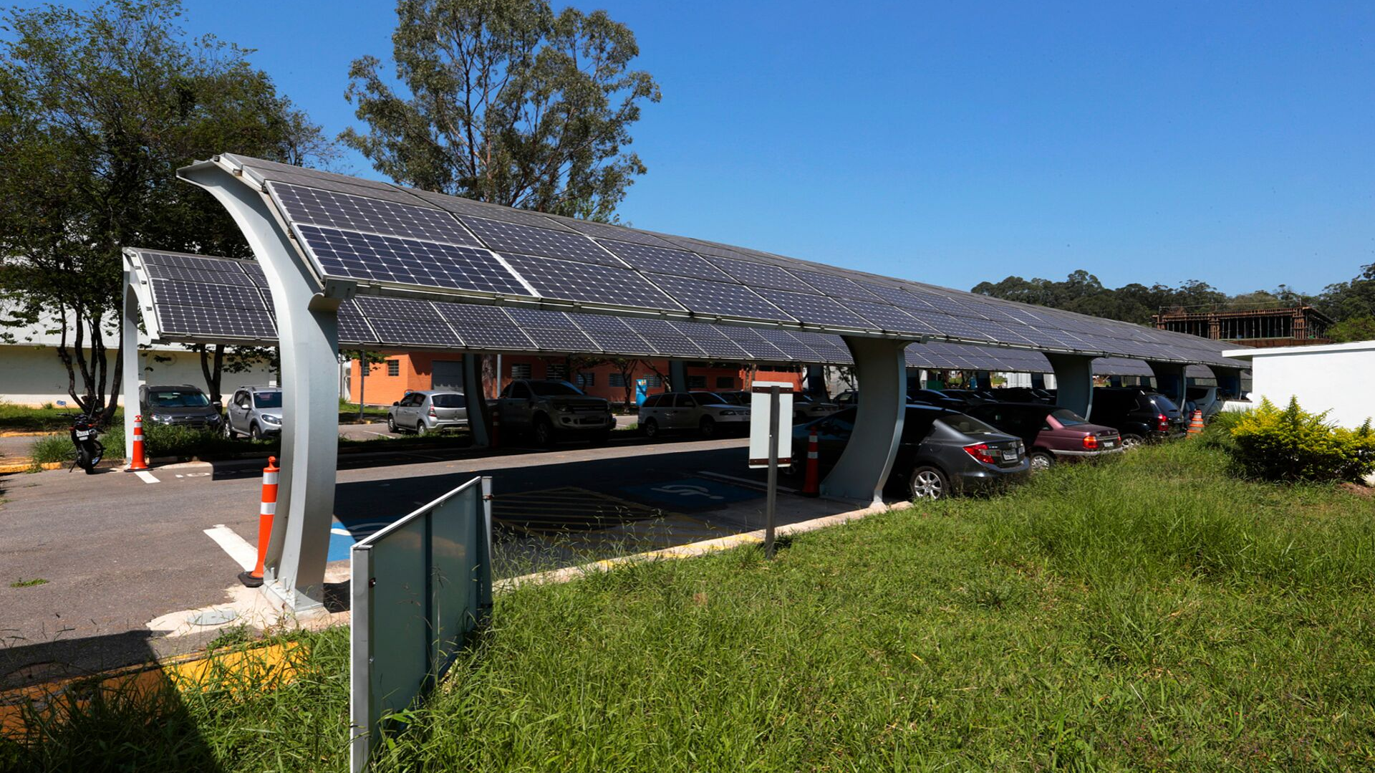
The Institute of Energy and Environment (IEE)
The Institute of Energy and Environment (IEE) is a Specialized Institute of the University of São Paulo with activities based on research, teaching and university extension in the fields of Energy and Environmental Sciences. The project's main objective is the continuous installation, operation and monitoring of a solar photovoltaic plant of 0.540 MW connected indirectly through consumer units to the electricity distribution network, consisting of four subsystems, incorporating the following concepts and studies: Building Integration (BIPV), Building Applied (BAPV), Solar Central, typologies and configurations of inverters and Power Factor Correction. The photovoltaic system was designed as a research project and developed with resources from companies in the electrical sector. It is divided into four systems, two situated at the IEE and one in Brasiliana Complex. The generated energy meets the demand of 1% of the entire campus. The visit to IEE consists of talking about the operations of a photovoltaic system and a tour of the system.

Slide 23
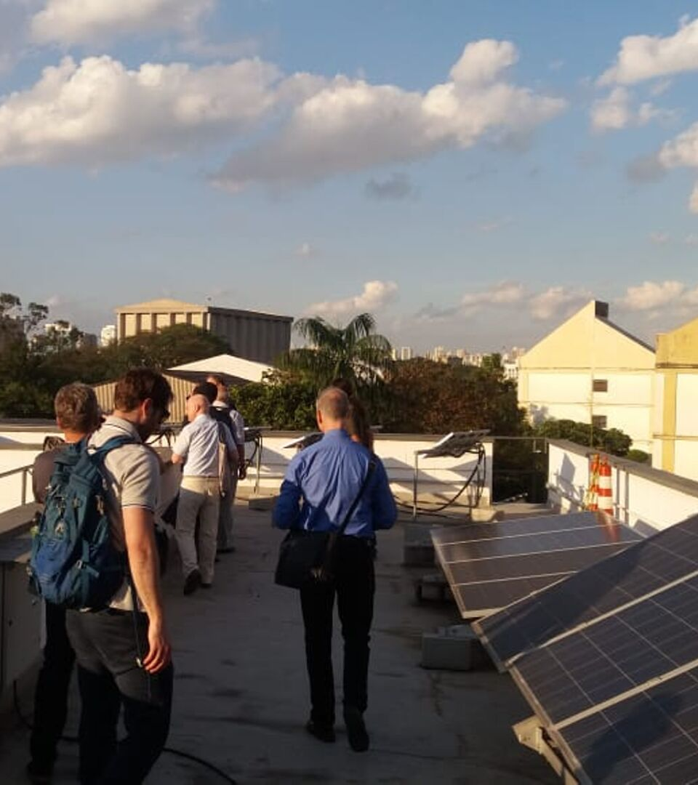
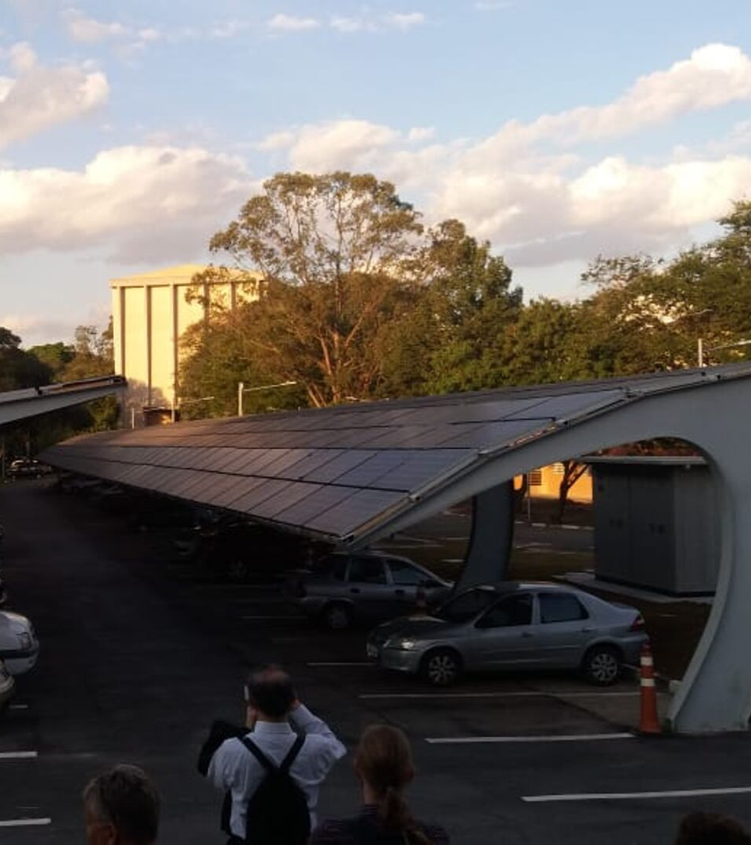
The Institute of Energy and Environment (IEE)
The visit to IEE consisted of talking about the operations of a photovoltaic system and a tour of the system. The group went to the place on foot, and had the opportunity to visit a small part of the campus. Arriving there, they observed the solar photovoltaic installation and IEE staff led us to the various projects and research areas.

Slide 24
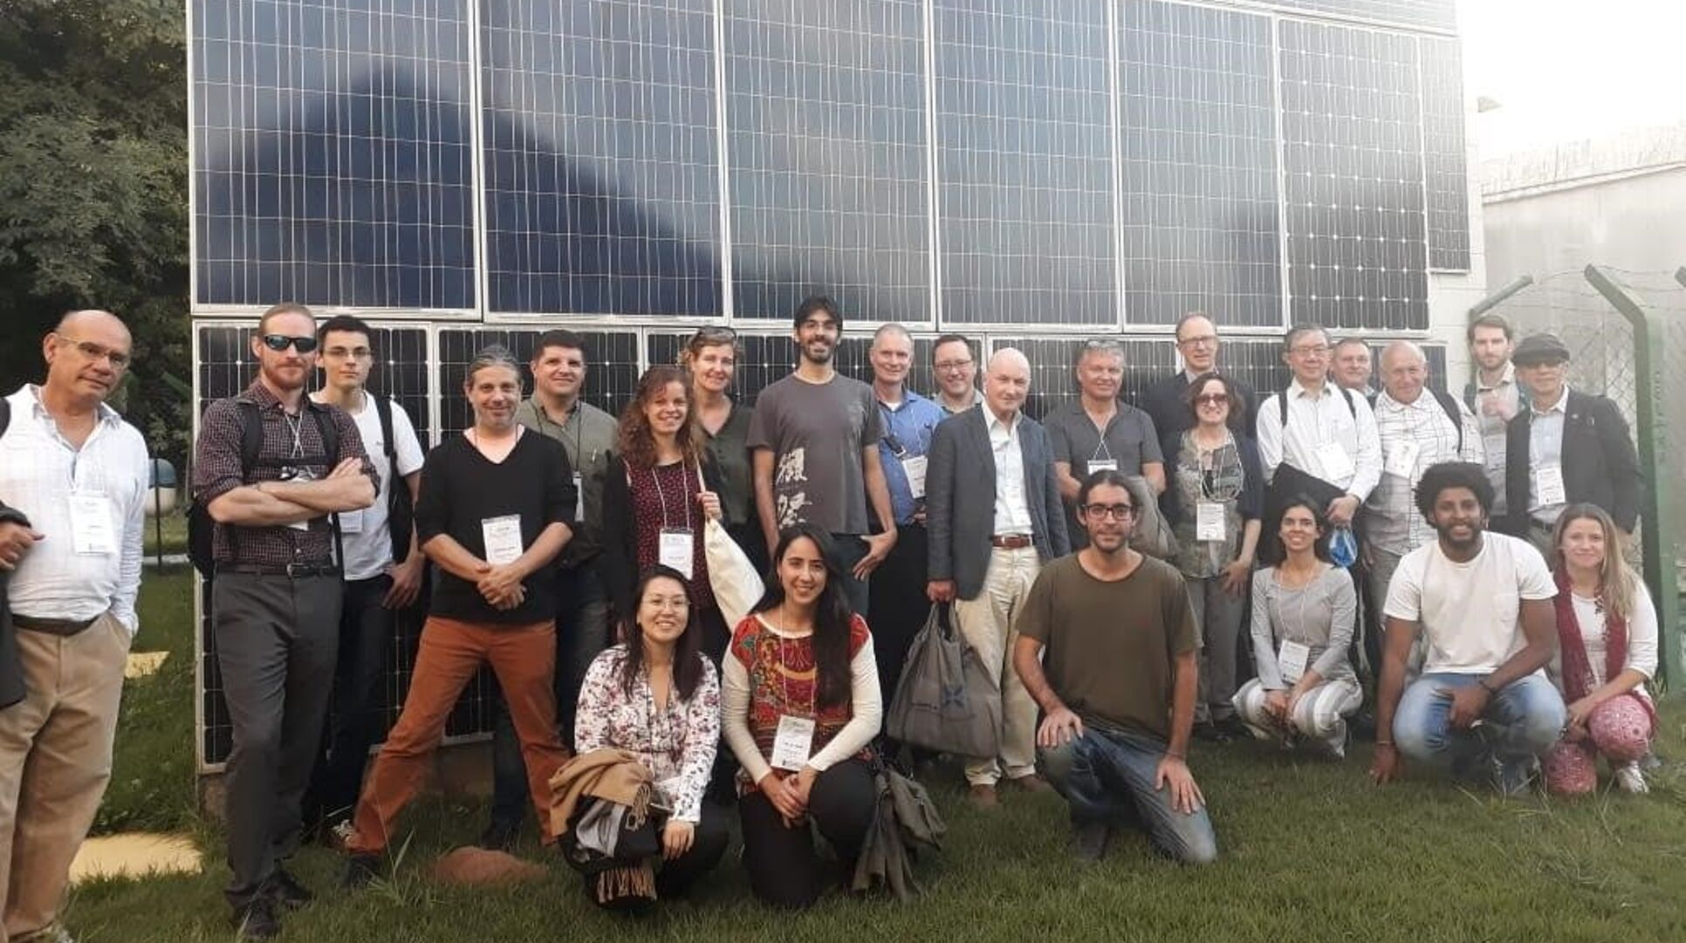
The Institute of Energy and Environment (IEE)

Slide 25
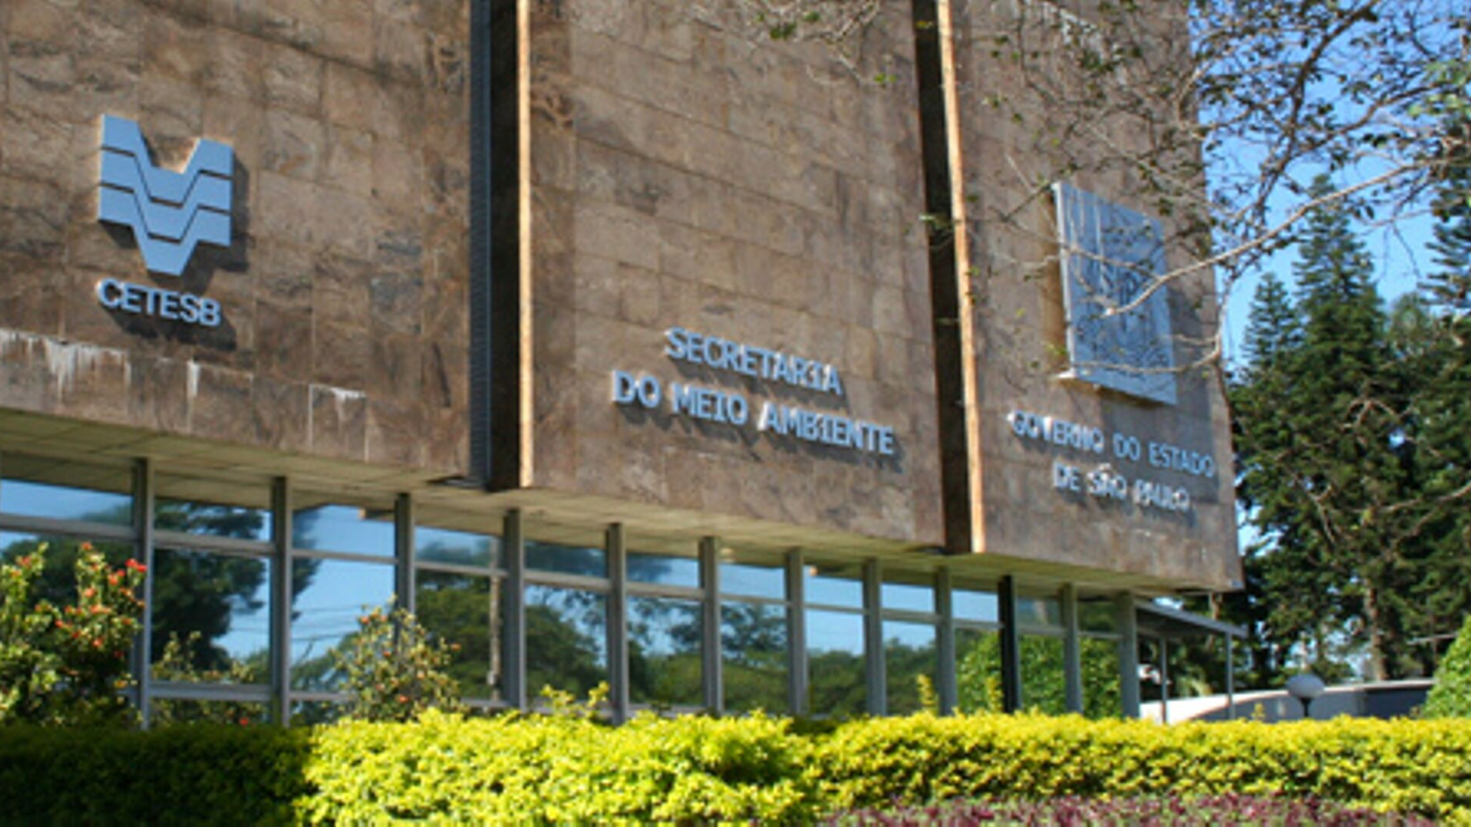
Day 2 - 13 June
At Environmental Agency Building
Environmental Agency intro & keynote
Rapid Round Presentations
Plenary Session 2: University of São Paulo Showcase Presentations
Breakouts:
Participative Approaches to Support Circular Economy & Waste Mitigation
Cultural Change & Strategy Setting
Data-Driven Change Management
Holistic Approaches to Food & Health
2019 ISCN Awards

Slide 26
Day 2 - Environmental Agency intro & keynote
Patricia Faga Iglecias Lemos, Professor, USP
Wanderley da Silva Paganini, Sabesp
Andrea Álvares, Chief Marketing, Innovation and Sustainability Officer and member of the Executive Committee, Natura

Slide 27
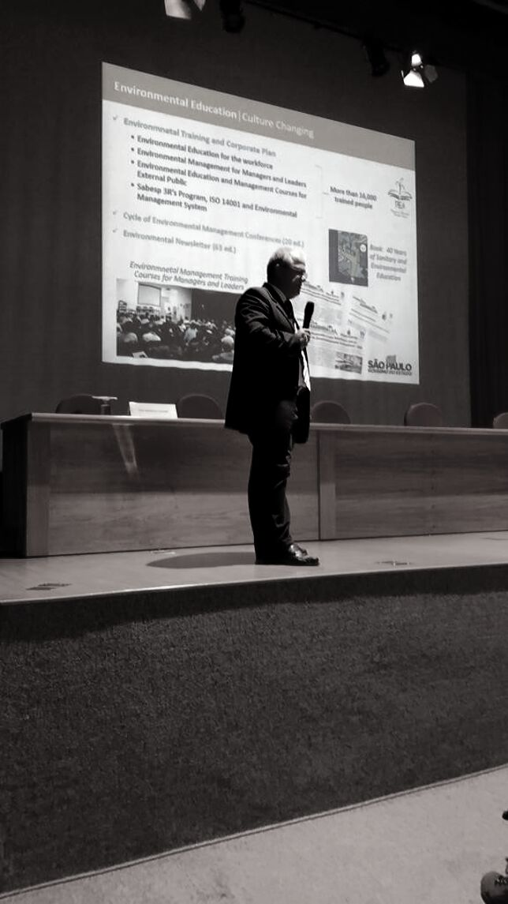

Slide 28
Rapid Round Presentations
École Polytechnique Fédérale de Lausanne - Luca Fontana, Sustainable Mobility Manager
Harvard University - David Havelick, Sustainability Manager, Harvard Office for Sustainability
Pontifical Catholic University of Rio de Janeiro - Melissa Casacchi, Technical Adviser
Universidade Federal de São Paulo - Matheus Pepe, student
University of São Paulo - Tereza Cristina Carvalho, Associate Professor

Slide 29
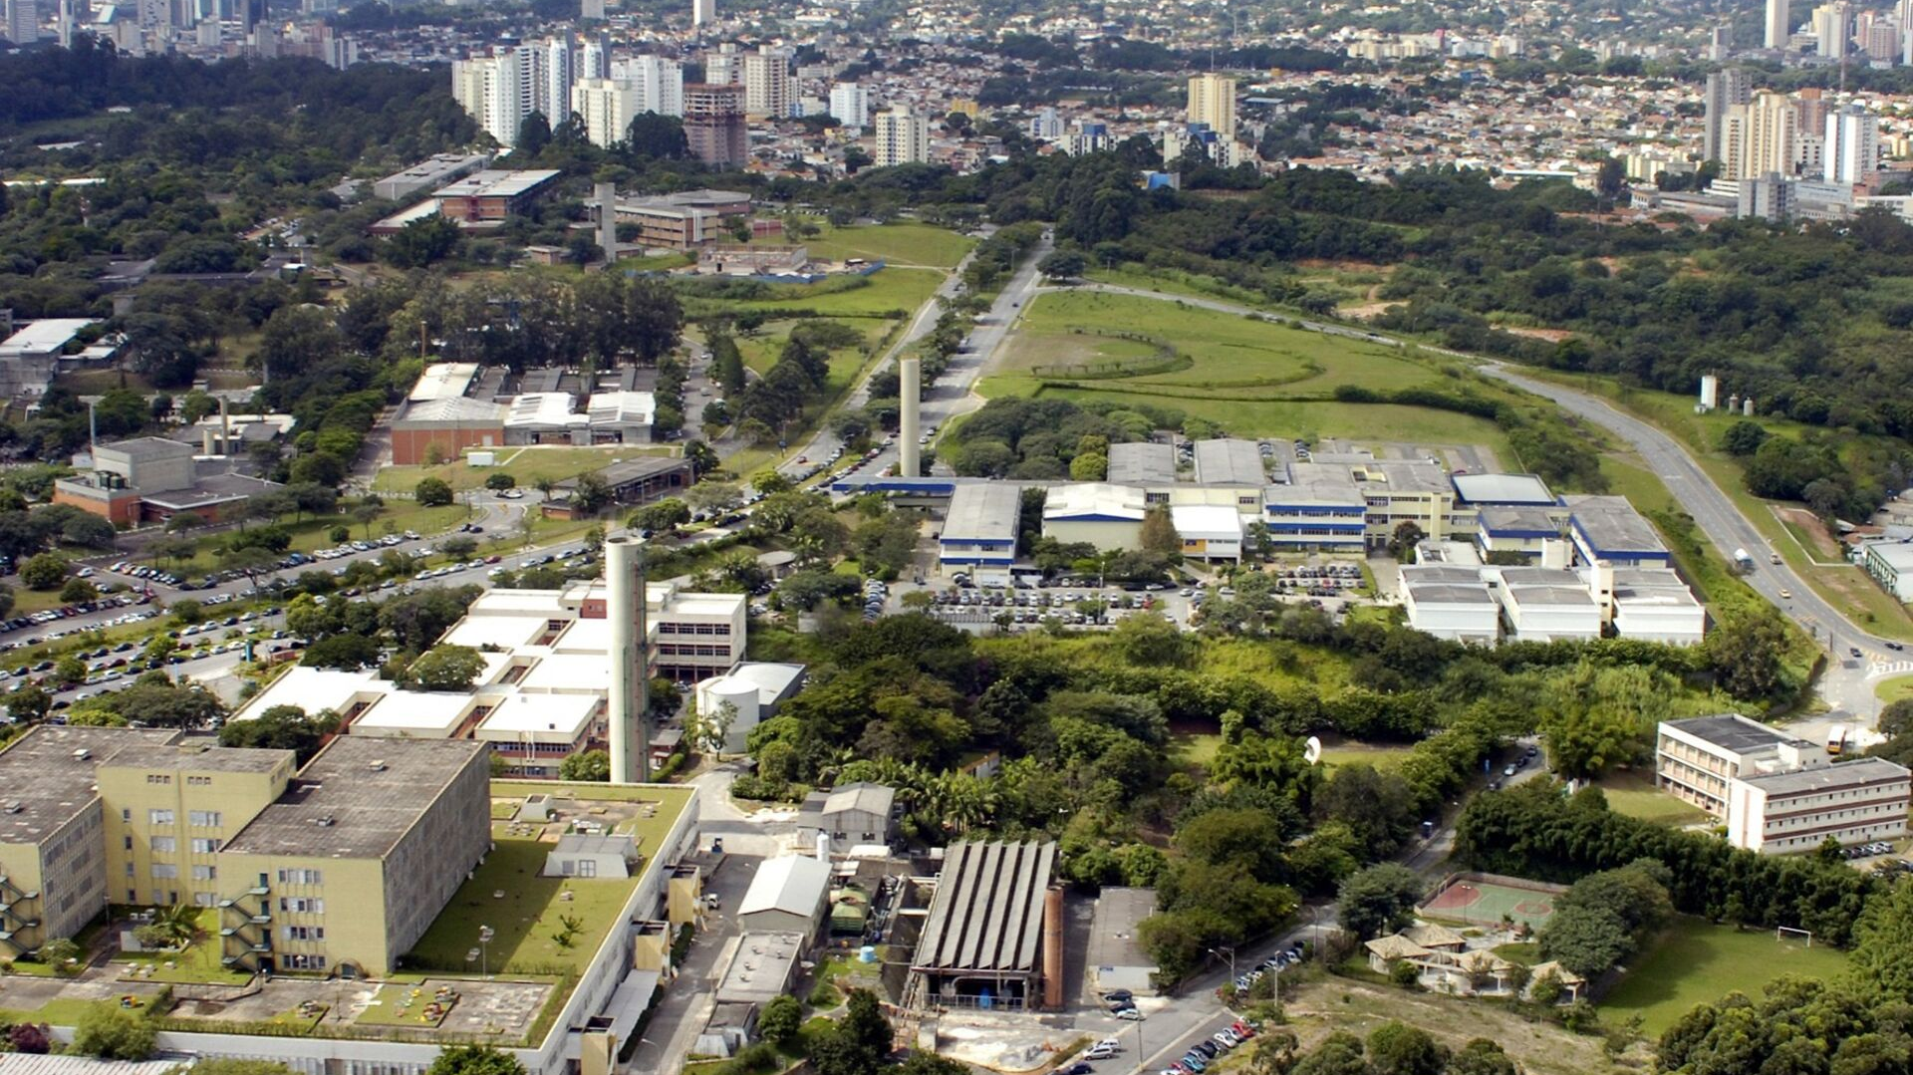
University of São Paulo Showcase Presentations
Professor Paulo Santos de Almeida - Environmental Law Professor in School of Arts, Sciences and Humanities, University of São Paulo
Professor Tadeu Fabricio Malheiros - Associate Professor in School of Engineering of São Carlos, University of São Paulo
Maria Cristina Santana Pereira - PhD Student at the Polytechnic School of the University of São Paulo (USP)

Slide 30
Breakout Sessions
Participative Approaches to Support Circular Economy & Waste Mitigation
Fahmida Ahmed Bangert - Director, Sustainability and Business Services, Stanford University
Prinya Thaewanarumitkul - Ph.D., Assistant Professor, Vice Rector for Sustainability and Rangsit Campus Administration, Thammasat University (moderator)
Joy Lam - Sustainability Office, University of Hong Kong
Cultural Change & Strategy Setting
Maria Djupström - Sustainability Strategist, Chalmers University of Technology
Ullika Lundgren - Sustainability Coordinator, University of Gothenburg
Eddi Omrcen - Sustainability Officer, University of Gothenburg
Lauren Hennessy - Outreach Program Manager, Office of Sustainability Stanford University
Emilio Latorre - Professor, Fundación Universitaria Católica Lumen Gentium
Thalita dos Santos Dalbelo - Coordinator of the Master Plan, University of Campinas

Slide 31
Breakout Sessions
Data-Driven Change Management
Derek Wietsma - Senior Data Analyst, Office of Sustainability, MIT
Jacob Steen Møller (moderator) - Director of Facilities and Real Estate, DTU
Alex Waegel - Center for Environmental Building + Design, University of Pennsylvania
Holistic Approaches to Food & Health
Dr. María del Coro Arizmendi Arriaga - Head of the Sustainability Coordination Office, Universidad Nacional Autónoma de México
David Havelick - Sustainability Manager, Harvard Office for Sustainability
Aneta Andrzejczyk - Deputy Director of the Office for Research, Strategies, and Development, Medical University of Lodz
Lea Lamotte - Student, Montpellier SupAgro
Massimiliano Rossetti - Sustainability Manager, University of Milano-Bicocca

Slide 32
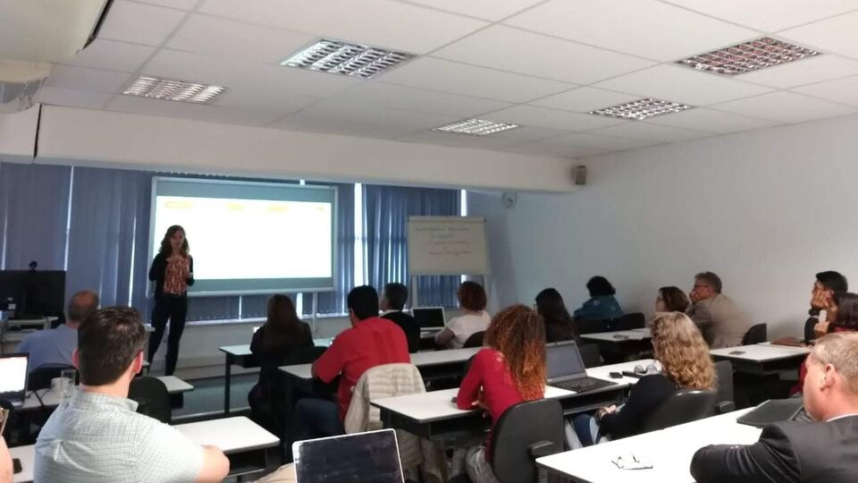
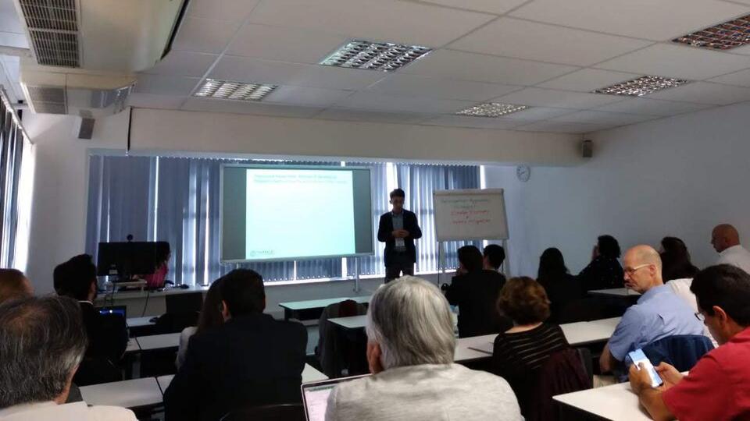
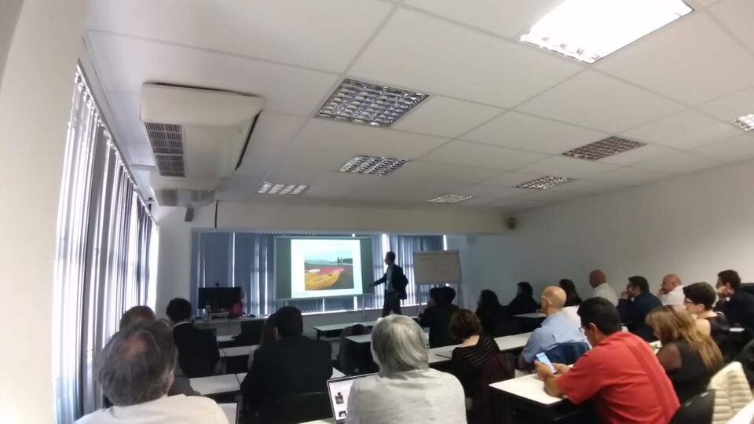
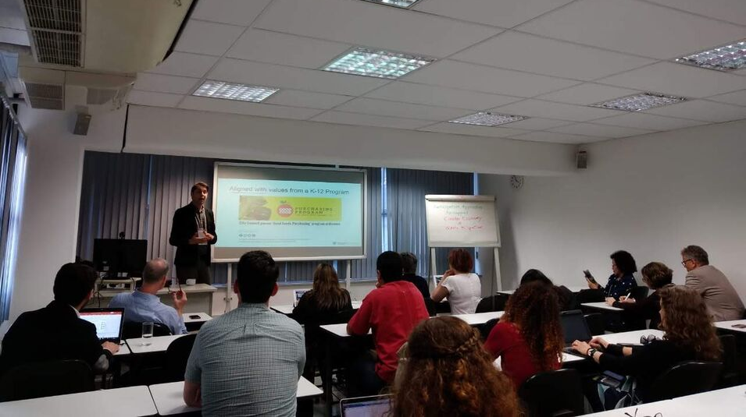
Breakout Sessions

Slide 33
Day 3 - 14 June
At Environmental Agency Building
Rapid Round Presentations
Plenary Session 3: Assessing SDGs Implementation Within Universities
ISCN Close Ceremony and Outlook

Slide 34
RAPID ROUND PRESENTATIONS
Ryan Jin - Lead (Smart Cities and Mobility), EcoLabs Centre of Innovation for Energy, Energy Research Institute, Nanyang Technological University
Francois Miller - Sustainability Director, McGill University
Rogério Benez - Production Engineer, Methodist University of Piracicaba
Prinya Thaewanarumitkul - Ph.D., Assistant Professor, Vice Rector for Sustainability and Rangsit Campus Administration, Thammasat University

Slide 35
ASSESSING SDG’S IMPLEMENTATION WITHIN UNIVERSITIES
Ryan Jin - Lead (Smart Cities and Mobility), EcoLabs Centre of Innovation for Energy, Energy Research Institute, Nanyang Technological University
Melissa Goodall (moderator) - Associate Director, Yale Office of Sustainability
Flavio Martins - Superintendence for Environmental Affairs,University of São Paulo
Duncan Ross - Chief Data Officer, Times Higher Education

Slide 36
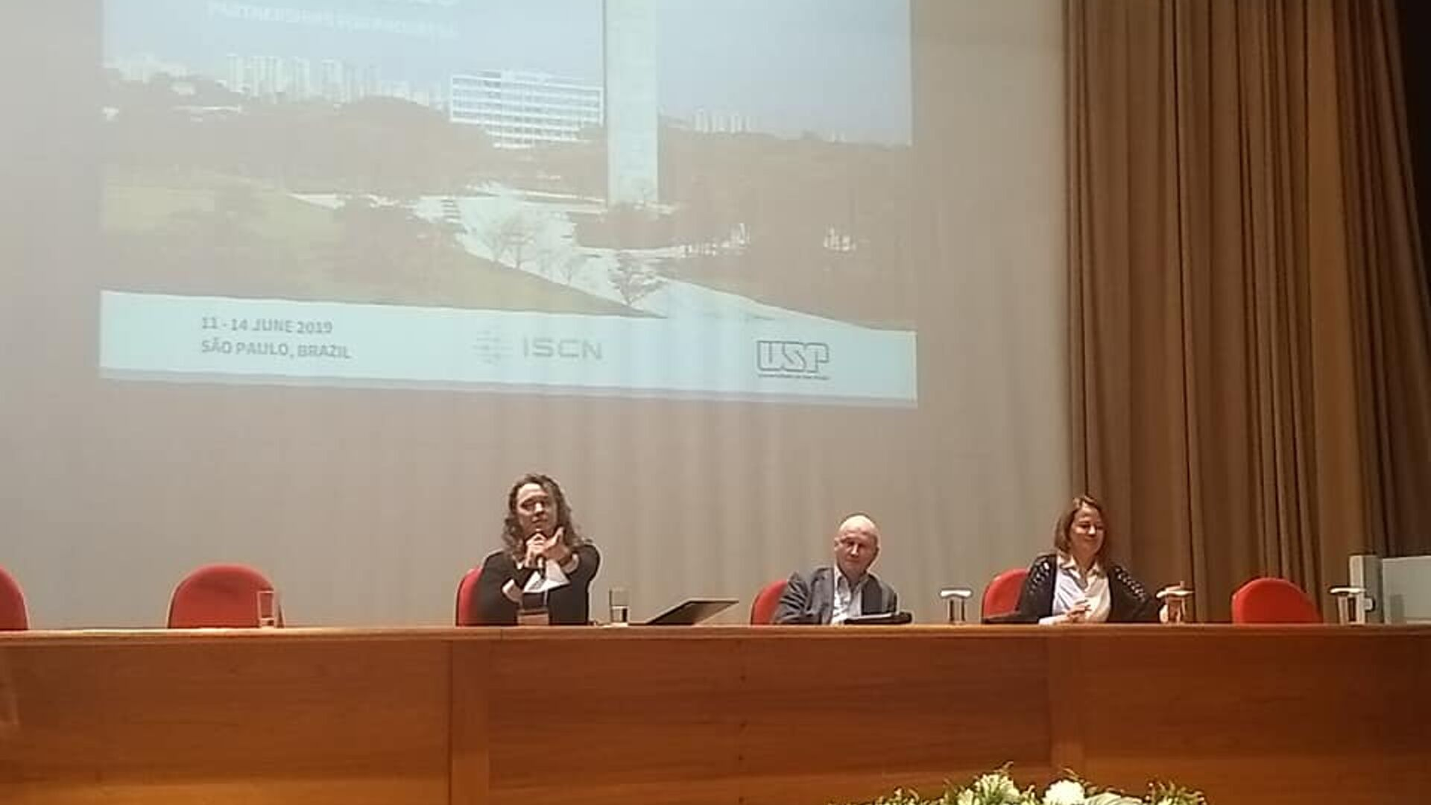
ISCN CLOSING CEREMONY & OUTLOOK
Etienne Marclay - Vice President of the ISCN Board, Vice President for Human Resources and Operations, EPFL
Patrícia Faga Iglecias Lemos, Professor at USP
René Schwarzenbach, President of the ISCN Board

Slide 37
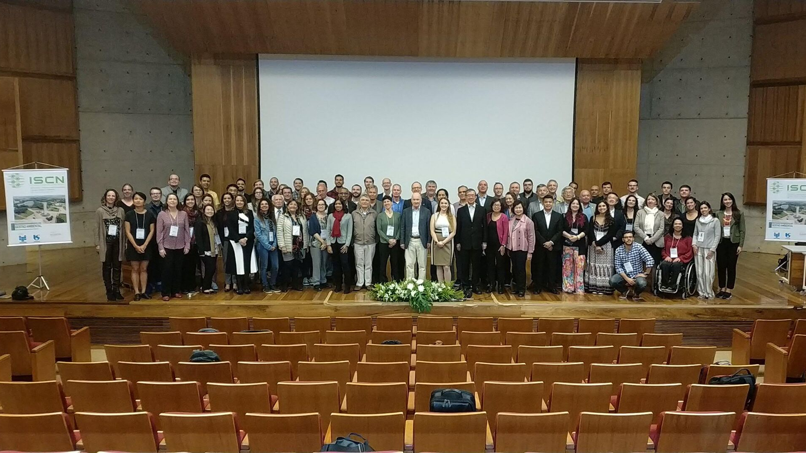
The mission of the International Sustainable Campus Network (ISCN) is to provide a global forum to support leading colleges, universities, and corporate campuses in the exchange of information, ideas, and best practices for achieving sustainable campus operations and integrating sustainability in research and teaching.

Slide 38
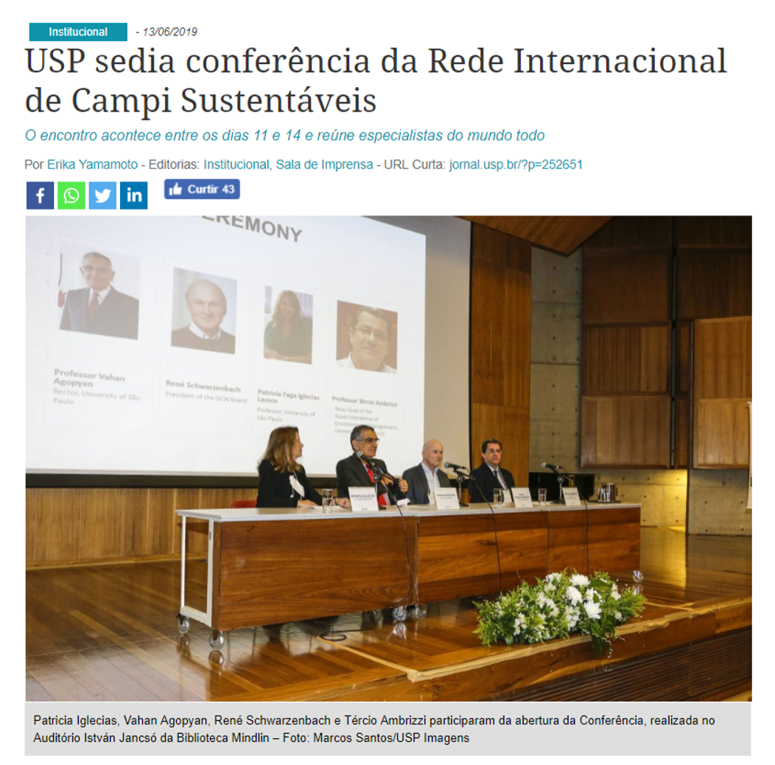
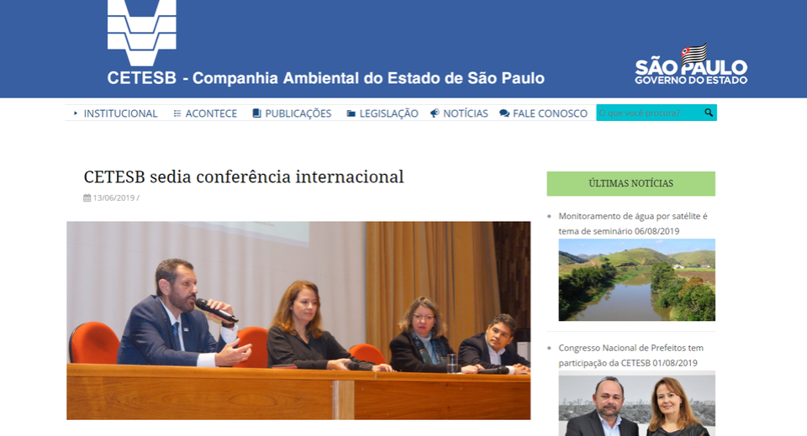
MEDIA REPORTS

Slide 39
International Sustainable
Campus Network
2019 São Paulo Conference
Photos: SGA Archive / USP Imagens / Marcos Santos
Conference Report - Superintendence of Environmental Management (SGA)

